Slide 1

HackBright Workshop
Matt Haines - @beardedinventor
Betsy Rhodes - @betsyrhodes
Gino Miglio - @collardgreens
Tom Byrne - @ersatzavian
While you are waiting please make sure you have downloaded the 'Electric Imp' app for mobile device

Slide 2

What are we doing tonight
Obligatory Internet of Things (IoT) Slide
Workshop
Getting your imp online
Controlling an LED with a button
Controlling an LED with an API
Controlling an LED with Twitter
Take home project
TempBug + SparkFun Data
https://github.com/beardedinventor/hackbright2k15

Slide 3

The Internet of Things

Slide 4
Let’s get started

Slide 5
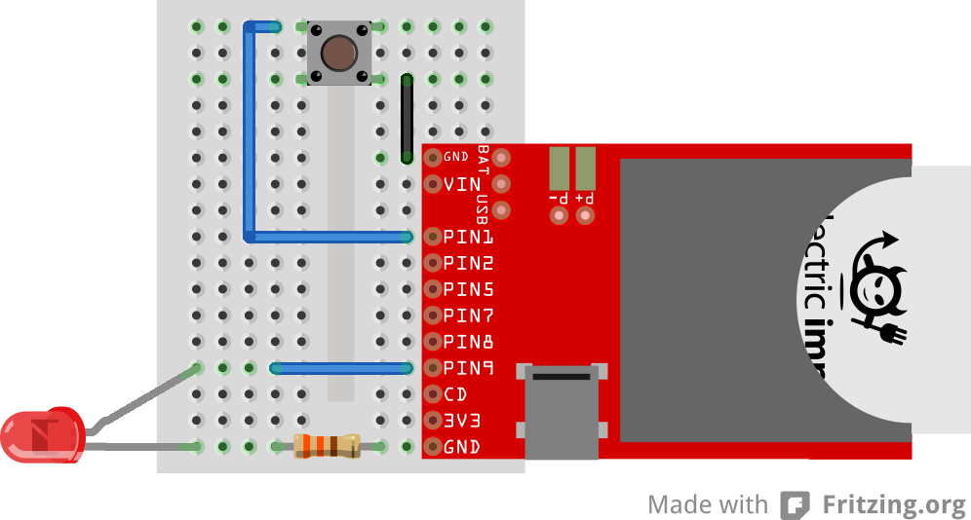
Build a circuit

Slide 6
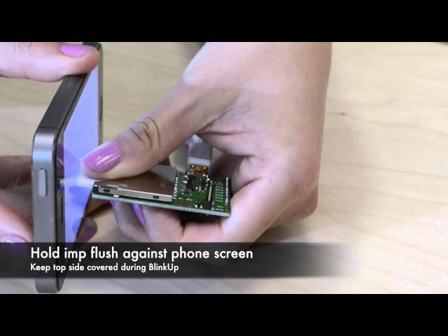
Getting your imp online

Slide 7
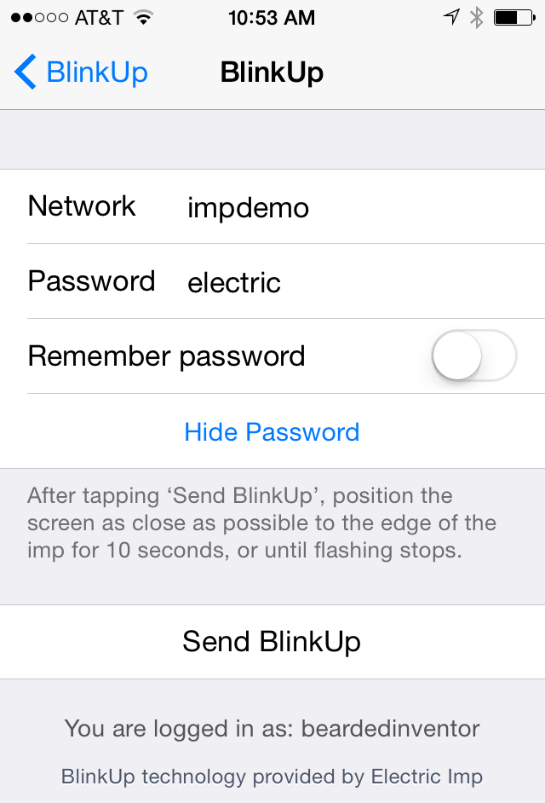
Getting your imp online
Download the Electric Imp mobile app (available on iOS and Android app stores)
Sign into the app with your Electric Imp Account
Choose "Other Network"
Enter WiFi credentials:
Network: impdemo
Password: electric
Power up your imp
The imp’s internal LED must be blinking
Click Send BlinkUp in the mobile app
Hold screen of phone against end of Imp until BlinkUp completes
Your device should now be blinking green (online)*
* Your imp will stop blinking after 1 minute to save power (it is still powered on)

Slide 8
Example 1 – Buttons & LEDs

Slide 9
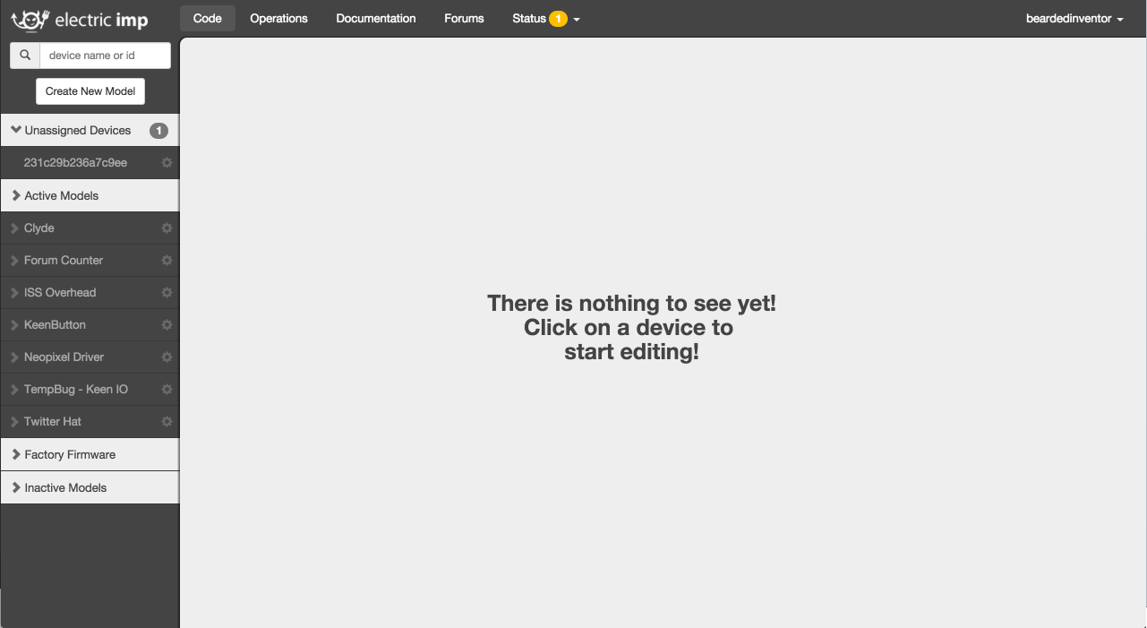
Example 1 – Controlling an LED with a Button
Hover here, then click the gear

Slide 10
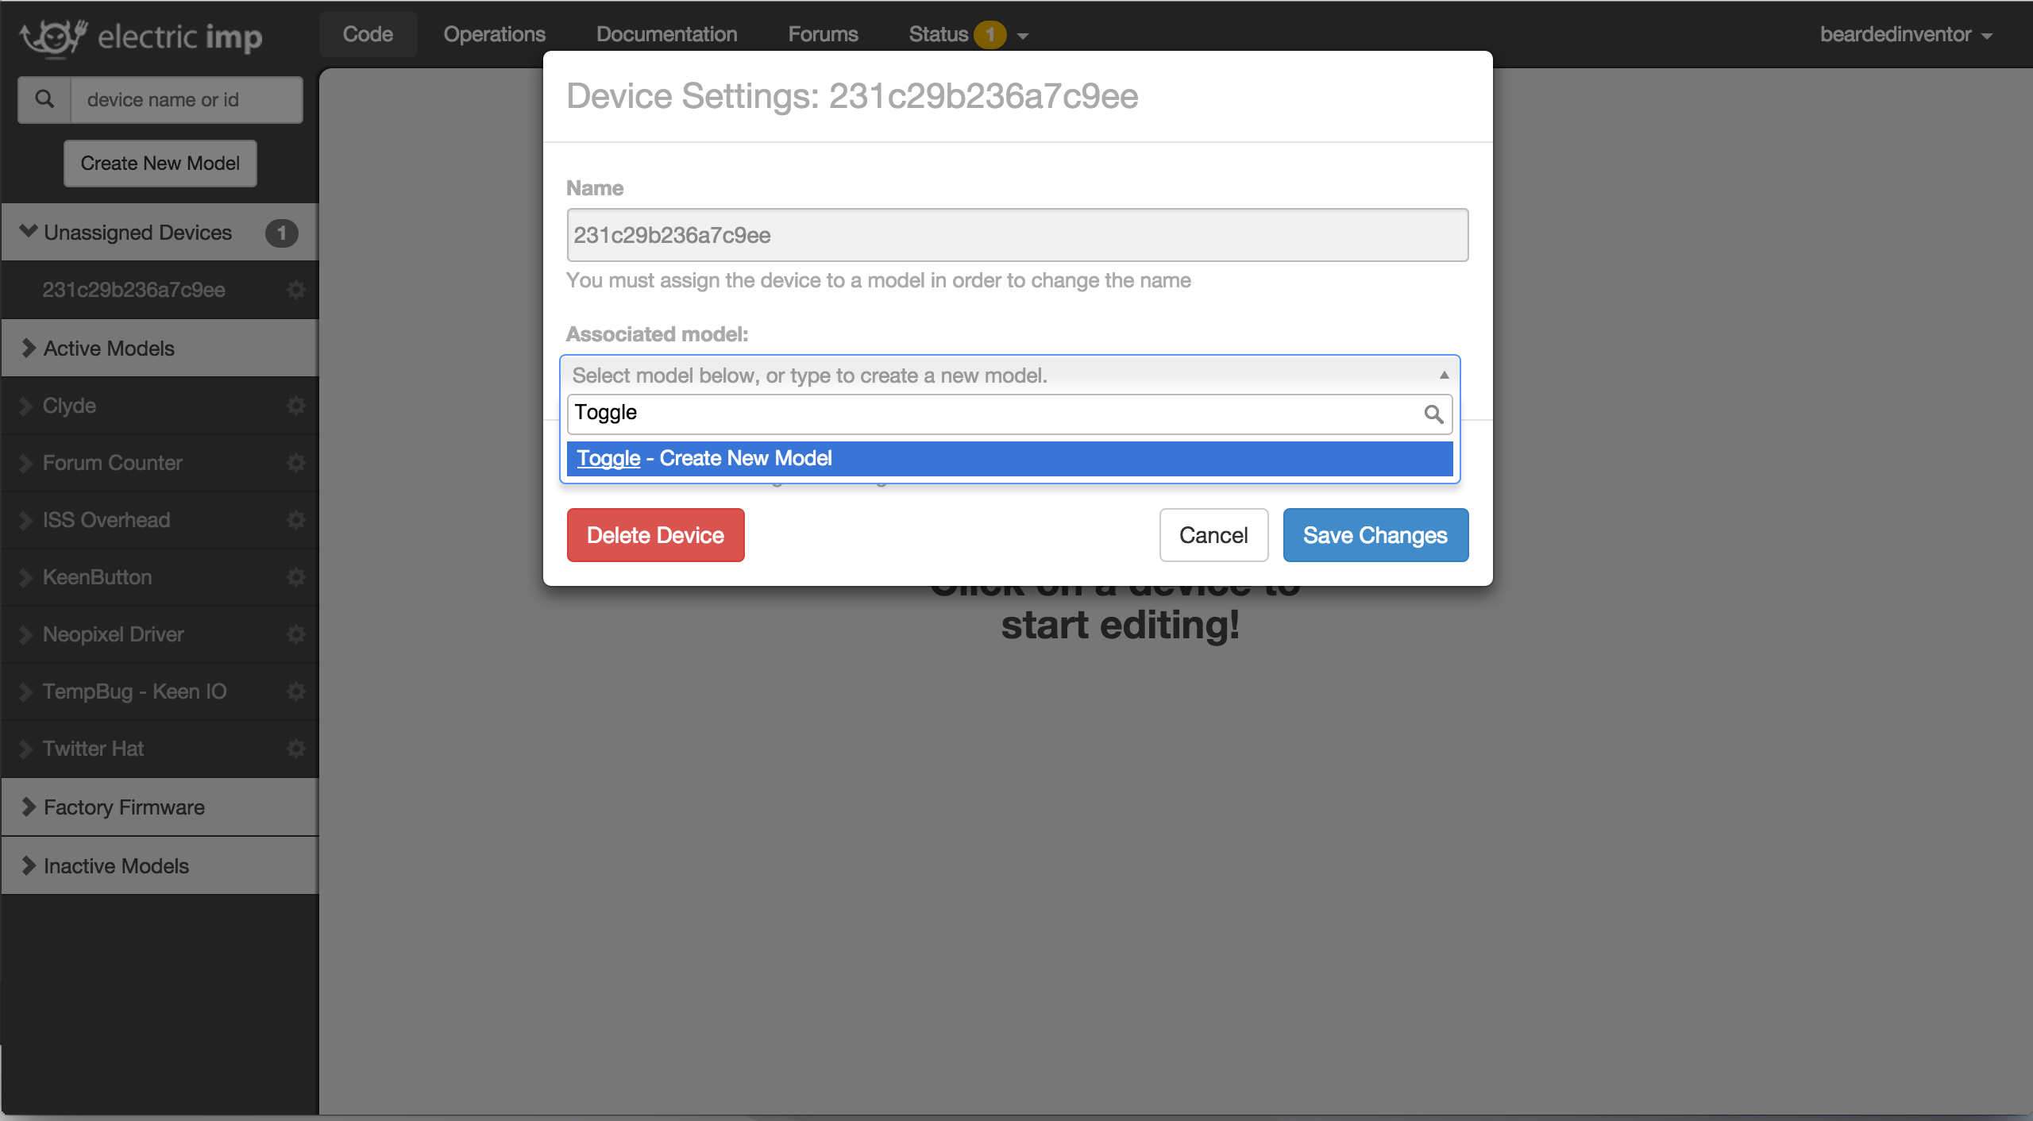
Example 1 – Controlling an LED with a Button

Slide 11
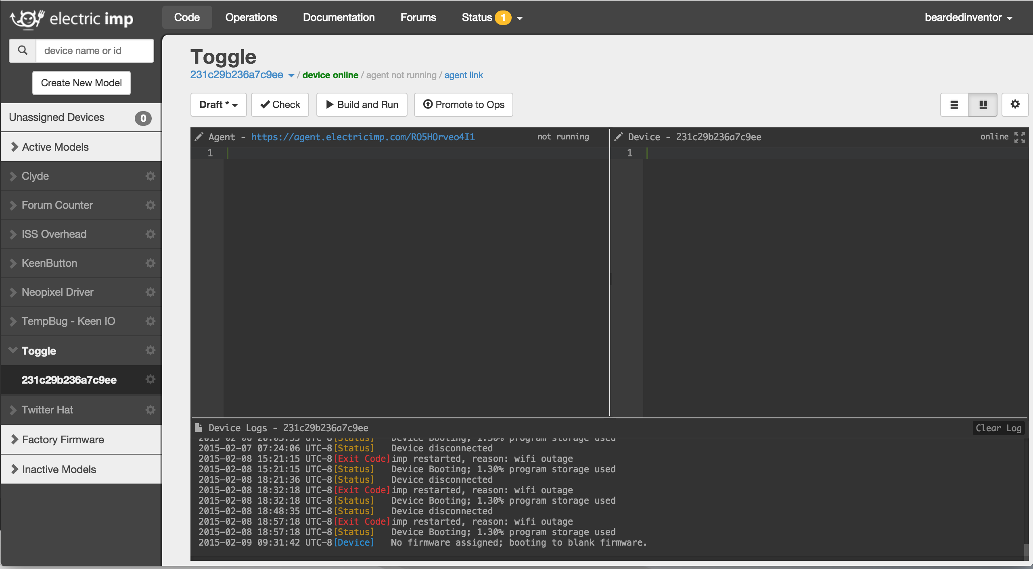
Example 1 – Controlling an LED with a Button
3
1
2

Slide 12
Example 1 – Controlling an LED with a Button
Agent Code
Device Code
Device Logs

Slide 13
Example 1 – Controlling an LED with a Button
https://github.com/beardedinventor/hackbright2k15/tree/master/toggle
Copy the code in toggle.device.nut into the device editor
Copy the code in toggle.agent.nut into the agent editor
Hit ‘Build and Run’
Play around with the button to see what happens!

Slide 14
Example 2 – LED API

Slide 15
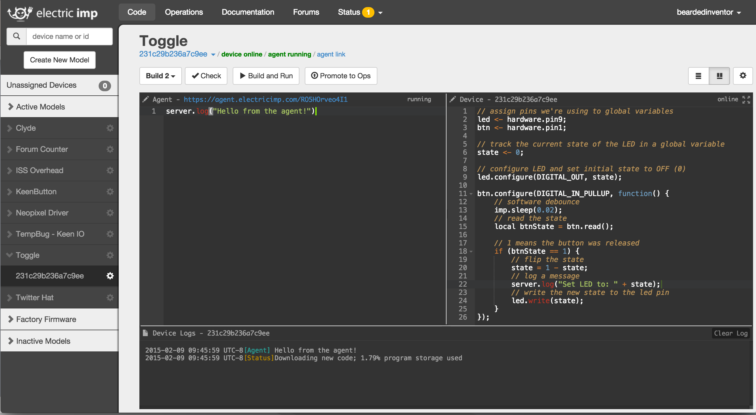
Example 2 – LED API
Hover here, then click the gear

Slide 16
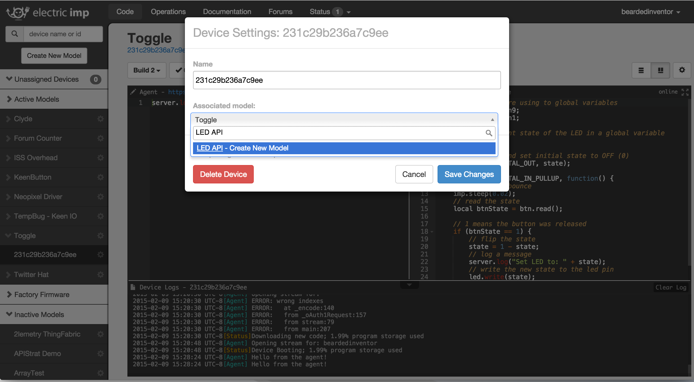
Example 2 – LED API

Slide 17
Example 2 – LED API
https://github.com/beardedinventor/hackbright2k15/tree/master/api
Copy the code in api.device.nut into the device editor
Copy the code in api.agent.nut into the agent editor
Hit Build and Run
* The URLs you need to control your LED should be in the Device Logs pane
Copy and paste the URLs into a new browser window (or cURL, etc) to control your LEDs
* These are endpoints on the Internet now, so anyone with the URL can control them
5) Bonus Points – Build a webpage/script to control your/your friends’ LEDs

Slide 18
Example 3 – Twitter Indicator

Slide 19
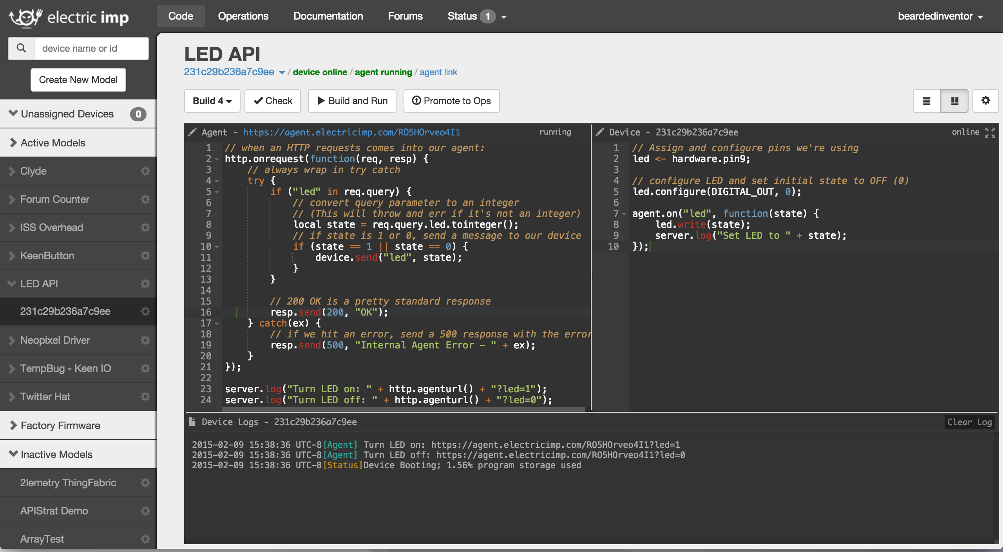
Example 3 – Twitter Indicator
Hover here, then click the gear

Slide 20
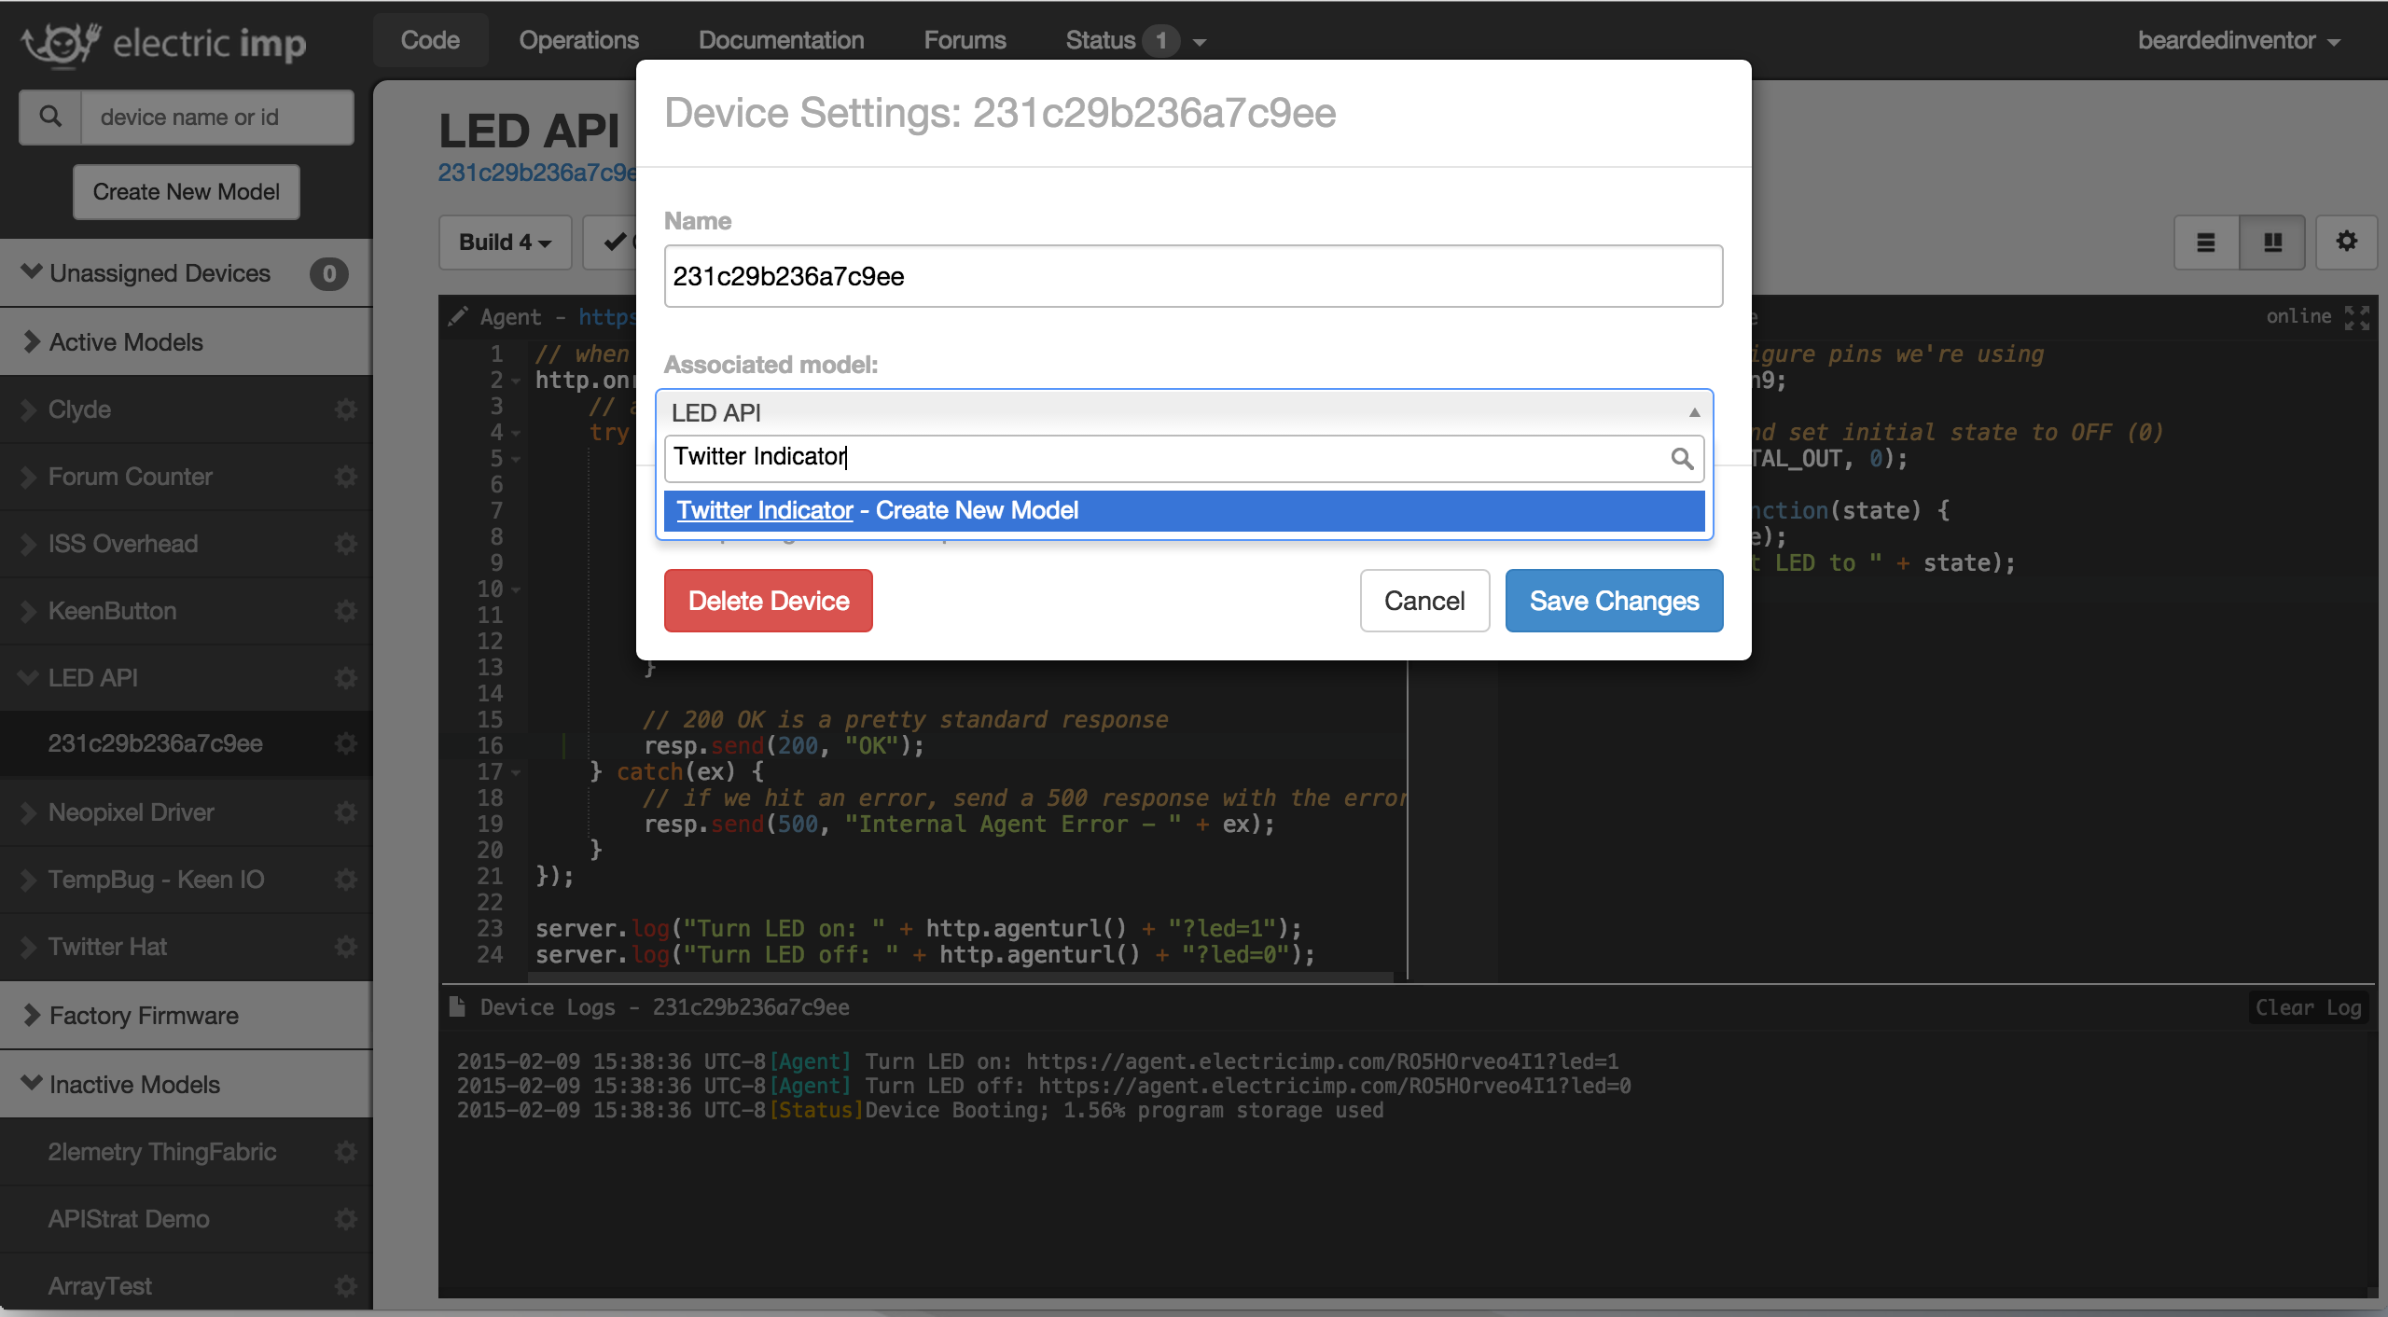
Example 3 – Twitter Indicator

Slide 21
Example 3 – Twitter Indicator
https://github.com/beardedinventor/hackbright2k15/tree/master/twitter
Copy the code in twitter.device.nut into the device editor
Copy the code in twitter.agent.nut into the agent editor
Setup your Twitter application
Copy the required tokens into your code
Hit ‘Build and Run’ and try tweeting with your tracked term to see what does

Slide 22
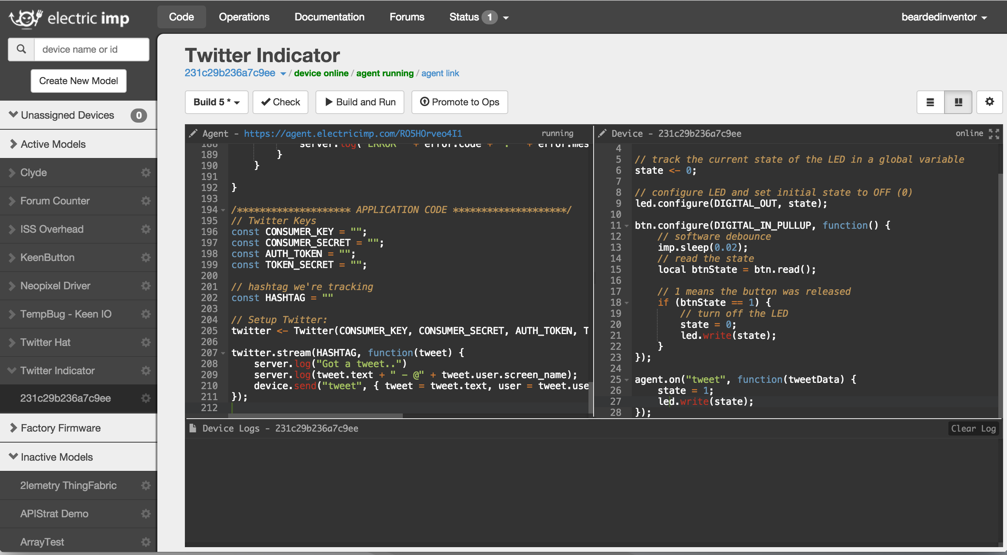
Example 3 – Twitter Indicator

Slide 23
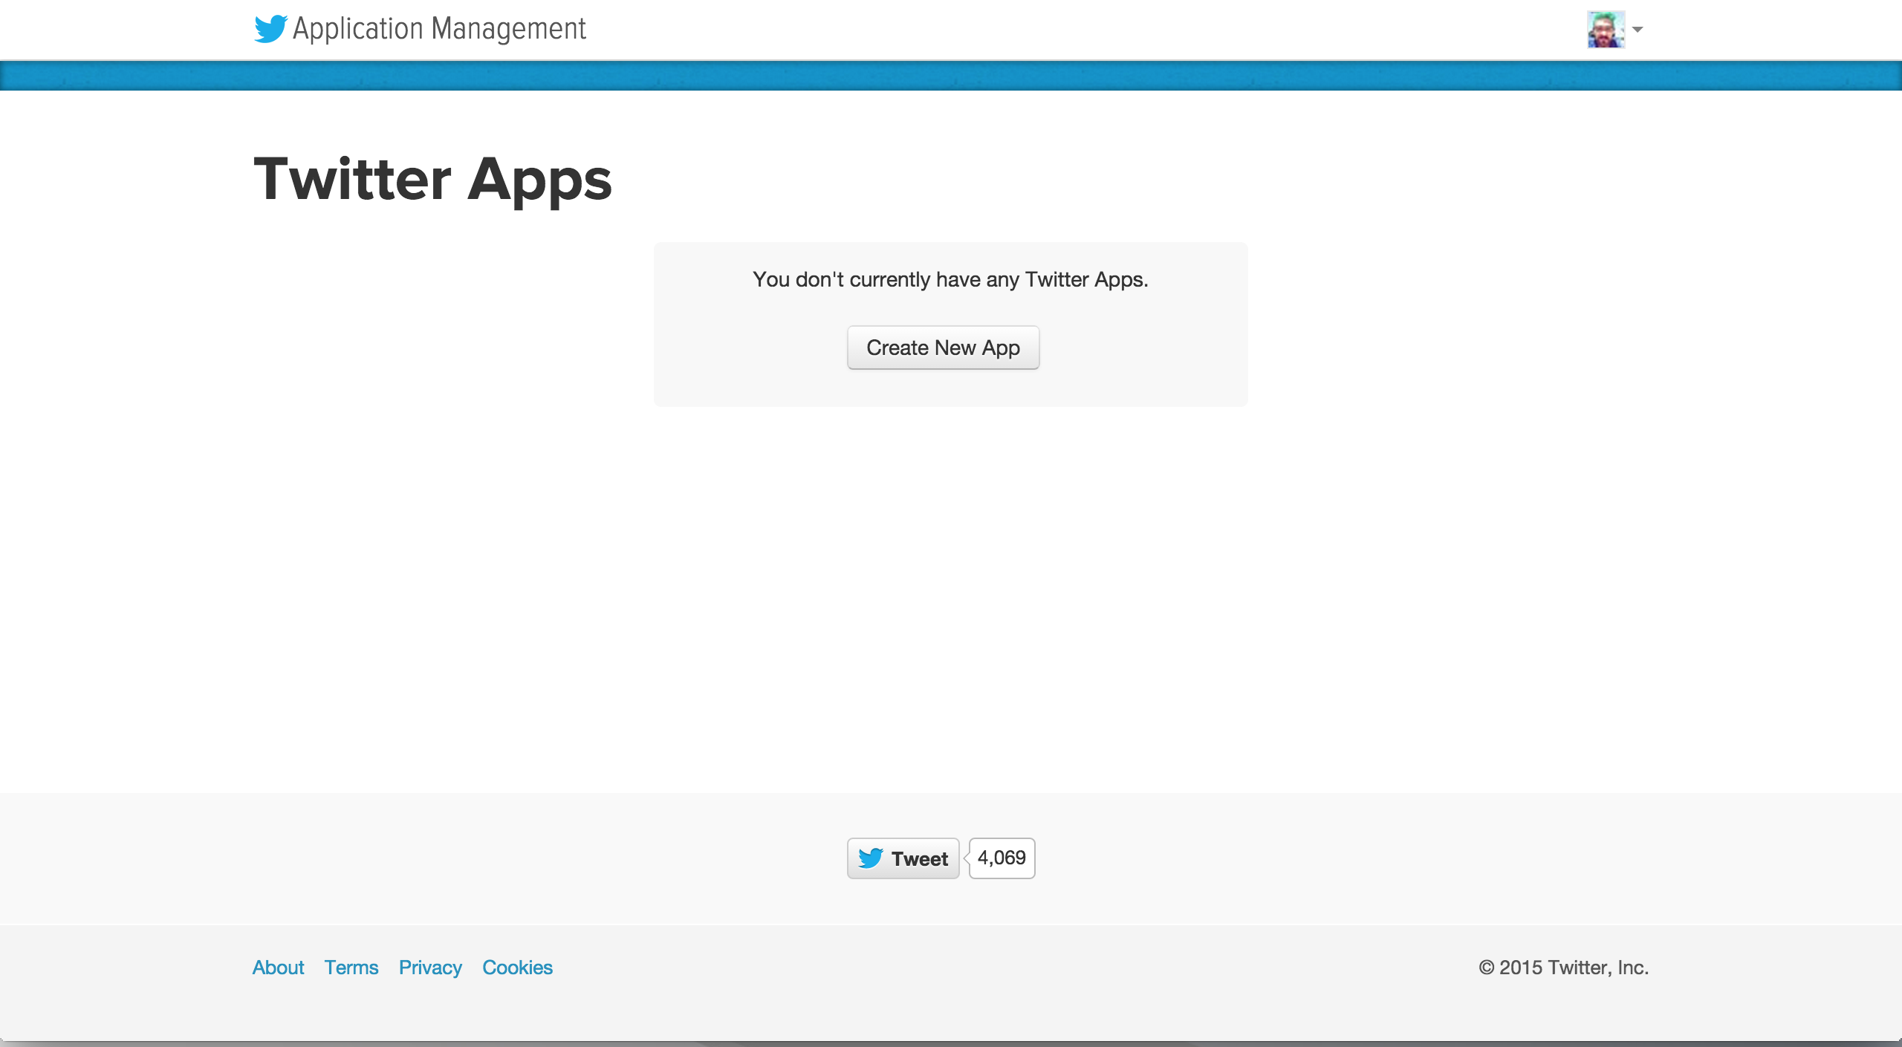
Example 3 – Twitter Indicator
http://apps.twitter.com
Notes:
imp.wakeup equivalent to Javascript setTimeout function

Slide 24
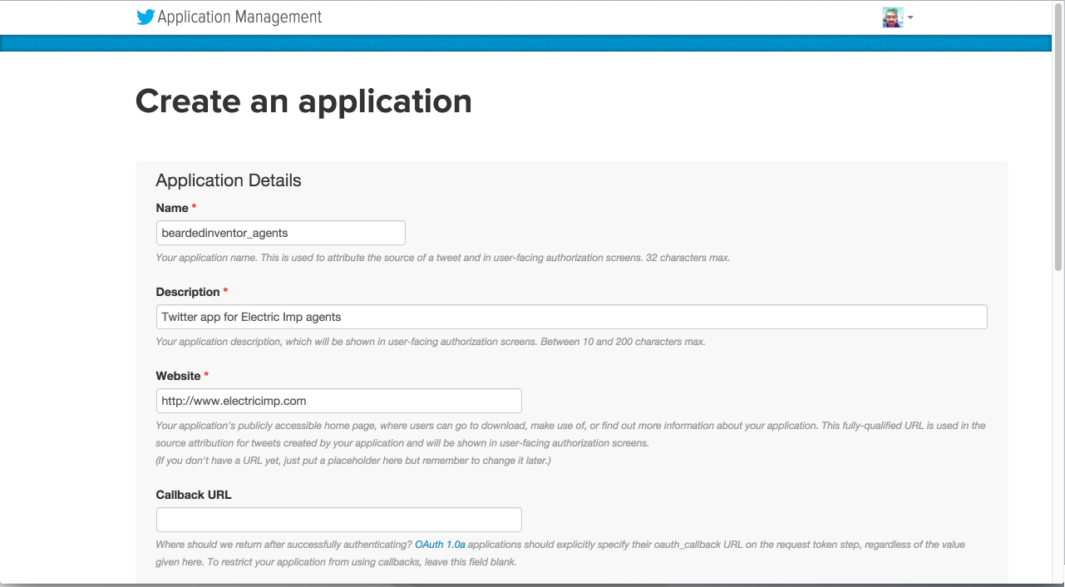
Example 3 – Twitter Indicator
Notes:
imp.wakeup equivalent to Javascript setTimeout function

Slide 25
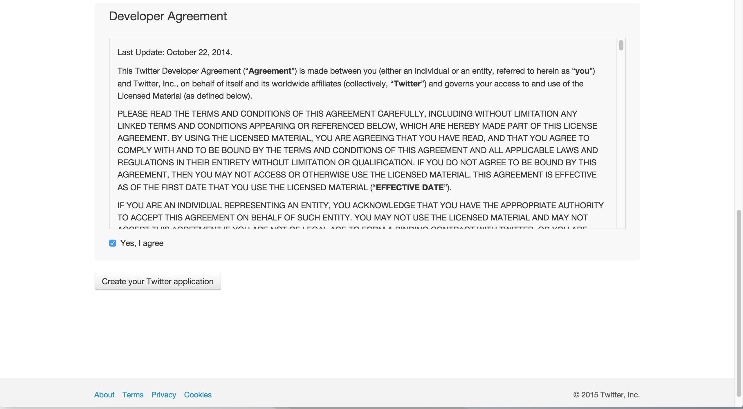
Example 3 – Twitter Indicator
Notes:
imp.wakeup equivalent to Javascript setTimeout function

Slide 26
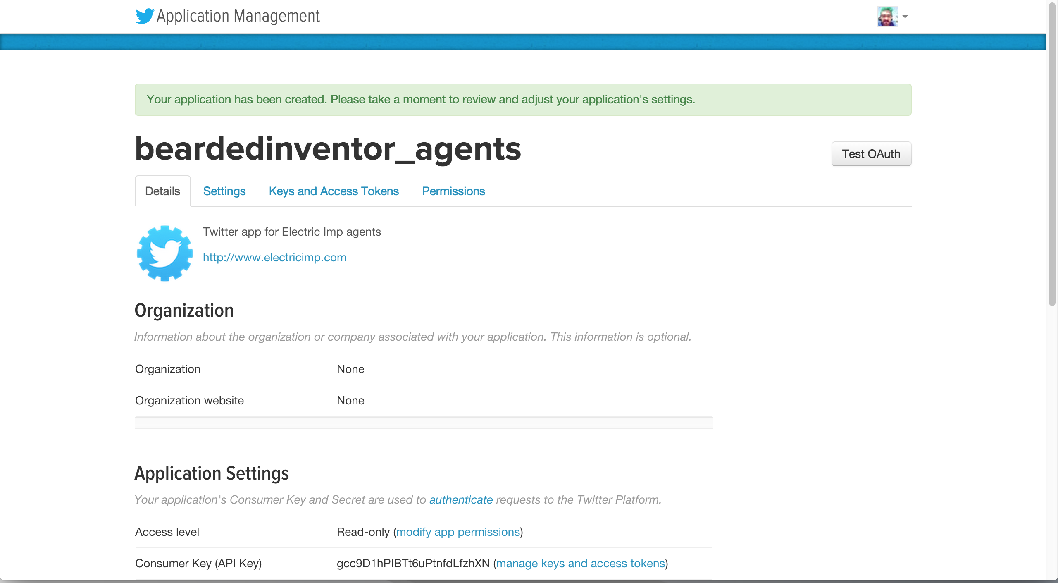
Example 3 – Twitter Indicator
Notes:
imp.wakeup equivalent to Javascript setTimeout function

Slide 27
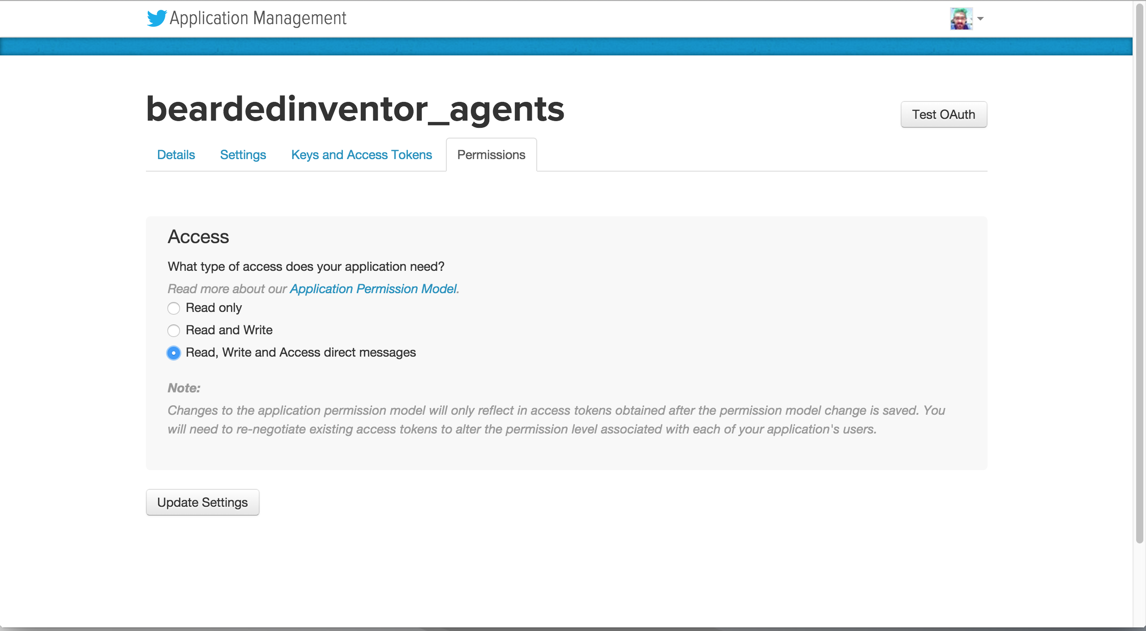
Example 3 – Twitter Indicator
Notes:
imp.wakeup equivalent to Javascript setTimeout function

Slide 28
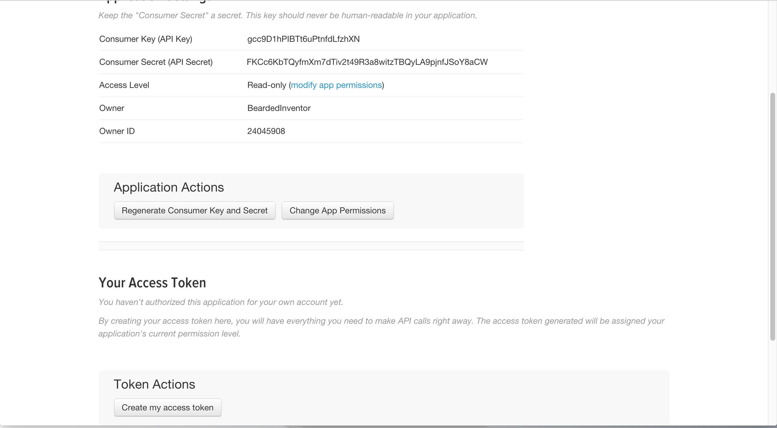
Example 3 – Twitter Indicator
Notes:
imp.wakeup equivalent to Javascript setTimeout function

Slide 29
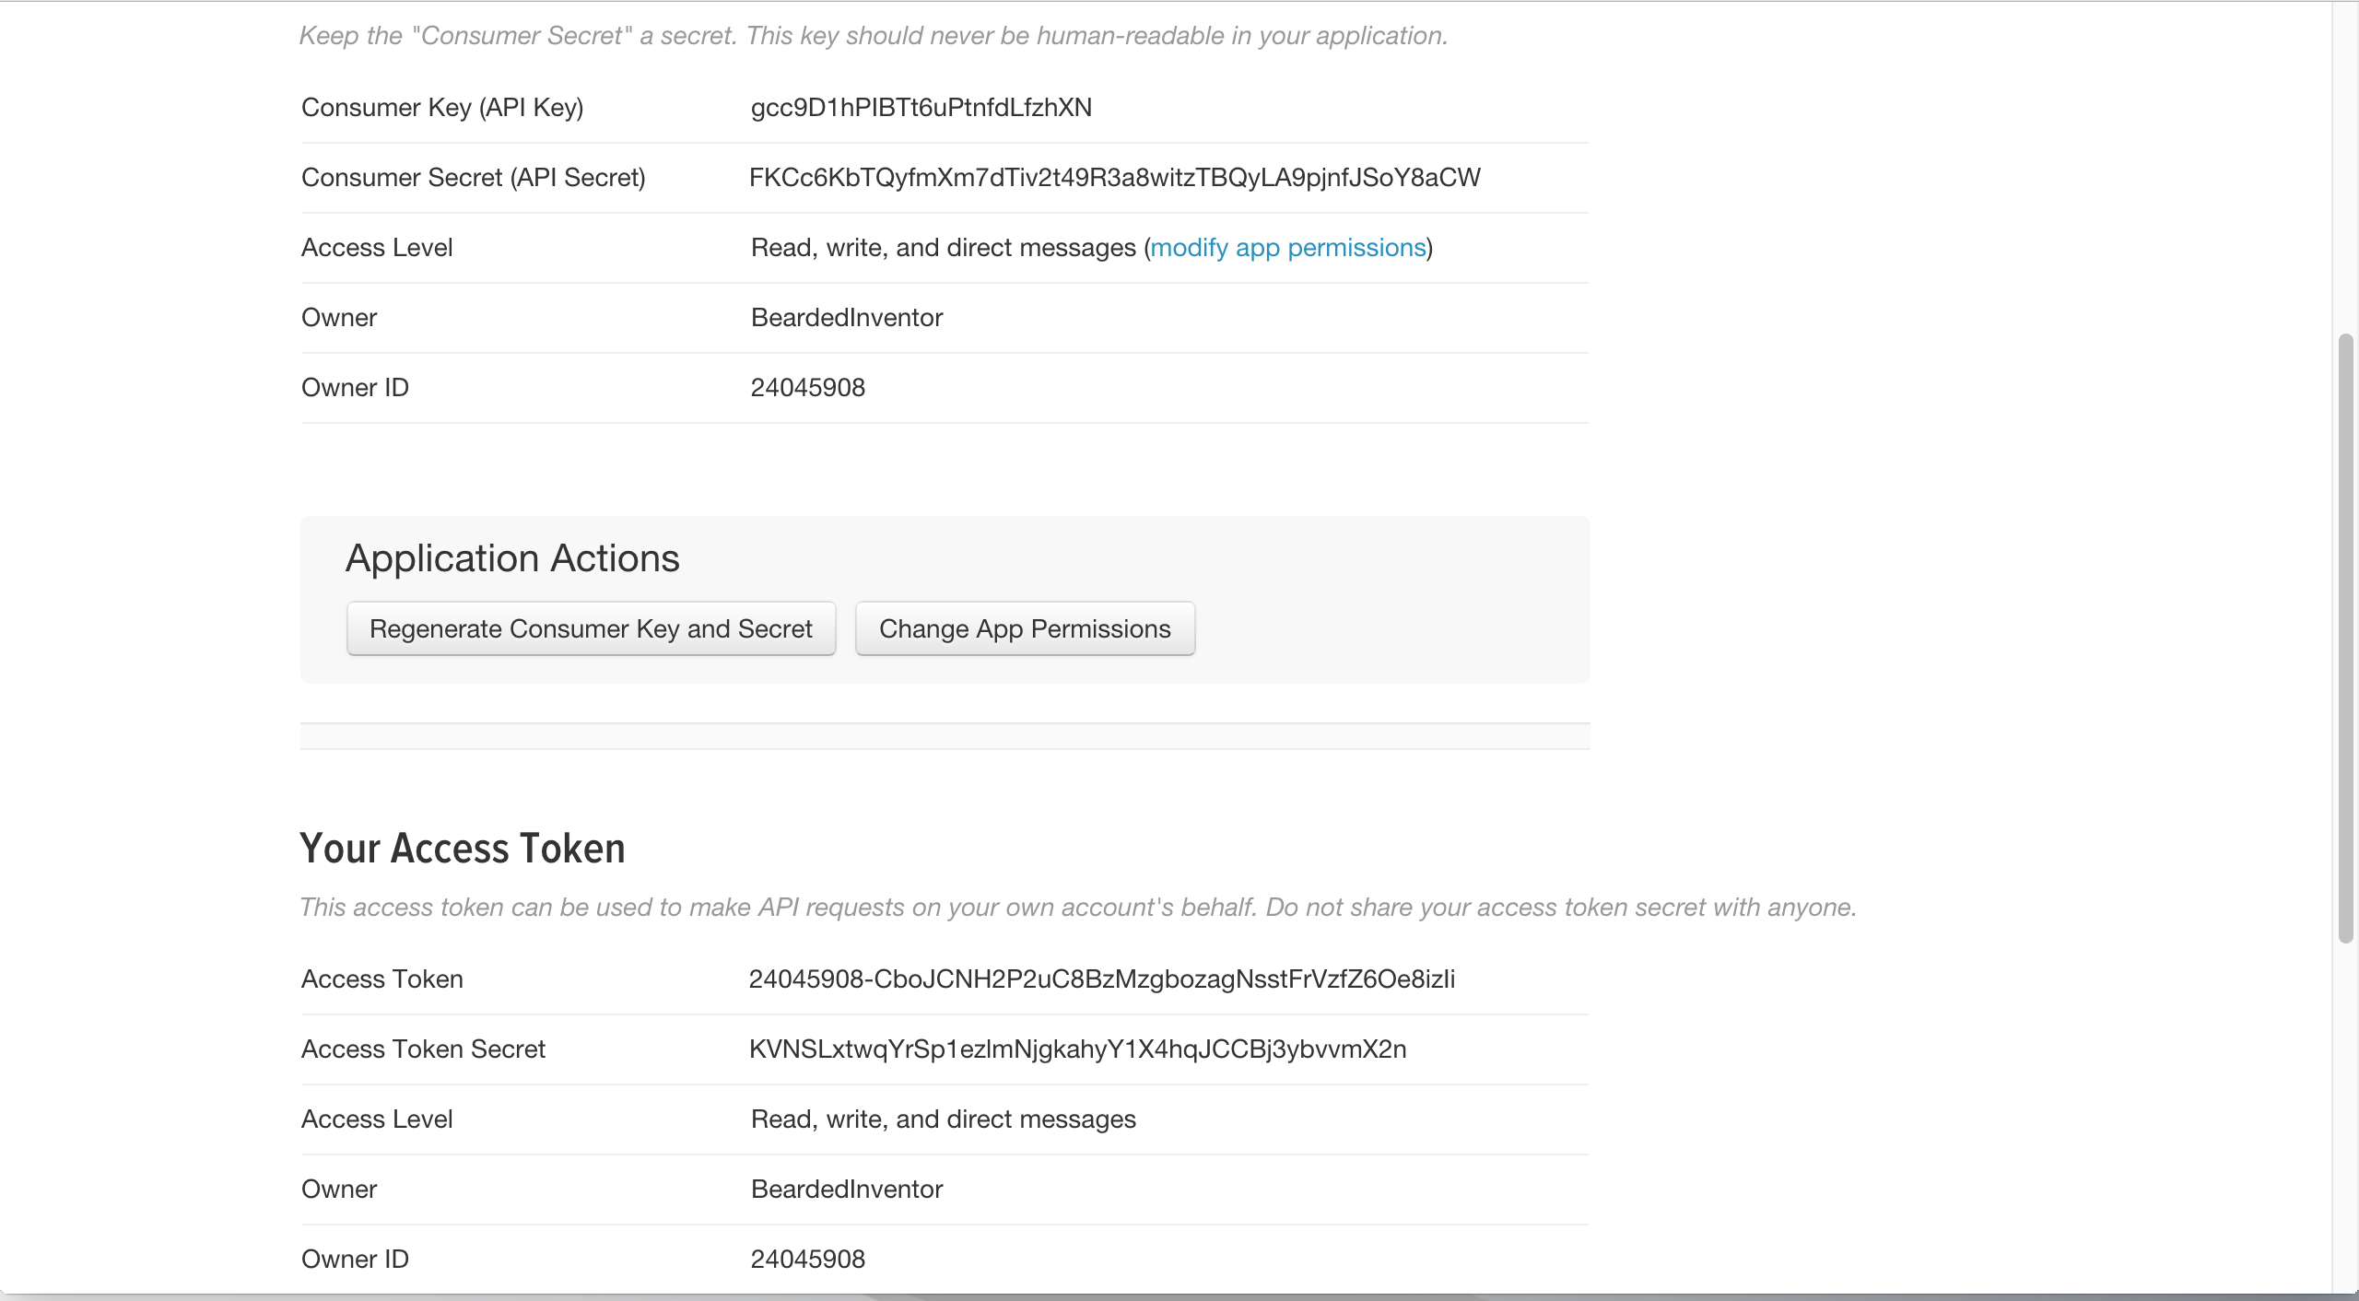
Example 3 – Twitter Indicator
Notes:
imp.wakeup equivalent to Javascript setTimeout function

Slide 30
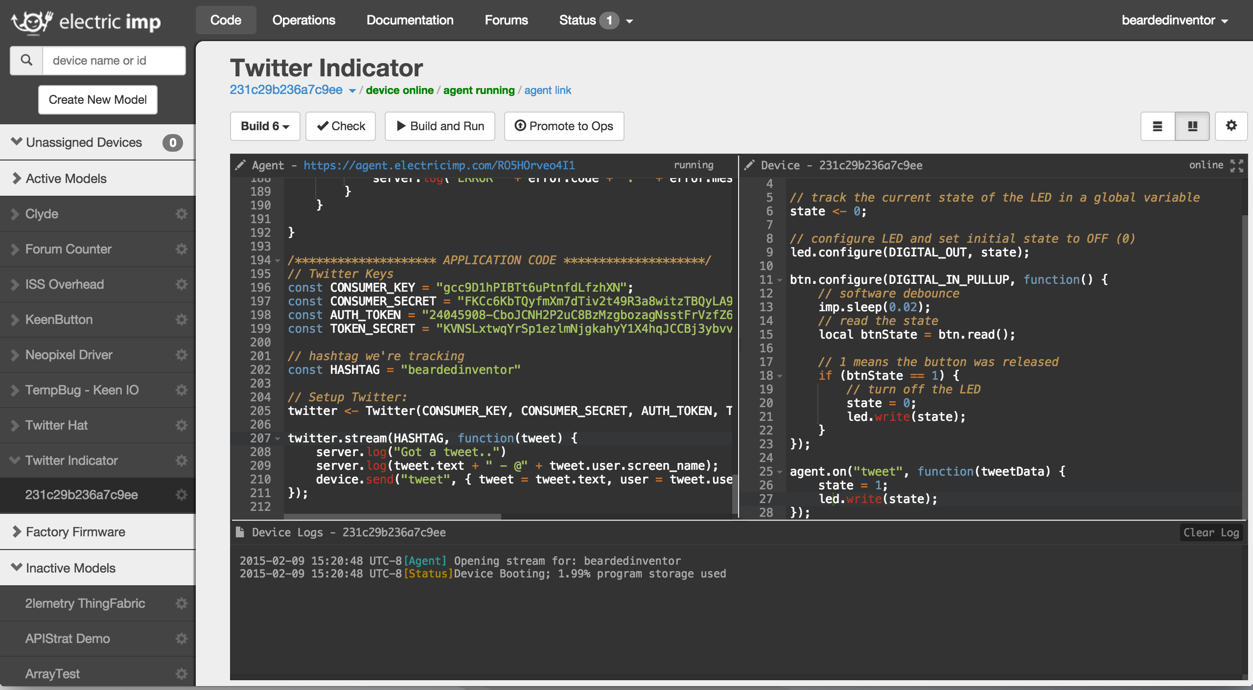
Example 3 – Twitter Indicator

Slide 31
Take home project - TempBug

Slide 32
TempBug + SparkFun Data
instructables.com/id/TempBug-internet-connected-thermometer
Follow the circuit wiring diagram
Ignore the battery clip and capacitor if you’re powering with USB
To build the battery version you’ll need a soldering iron, so check out a local hackerspace!!

Slide 33
Additional Resources
Getting Started electricimp.com/docs/gettingstarted
API Docs electricimp.com/docs/api
Squirrel Docs electricimp.com/docs/squirrel
GitHub github.com/electricimp
Community Blog community.electricimp.com
Forums forums.electricimp.com
Questions?

